Slide 1
Welcome Kindergarten Families!
2017/2018

Slide 2
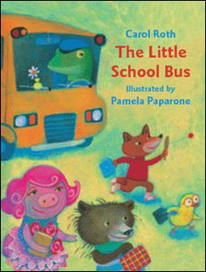
Reading Street is a comprehensive, common-core based English Language Arts curriculum. It covers content areas in both science and social studies while teaching your child skills in writing, speaking and listening, language, comprehension, and phonics.
Student Resources to view:
Readers and Writers Notebook
My Skills Buddy
Decodable Readers
Online Resources: https://www.pearsonrealize.com/community/program/f5427c09-3280-34cb-bde2-ce090e8ae771/16/tier/c9070927-4aab-311e-b4d8-44da281d75f4/19

Slide 3
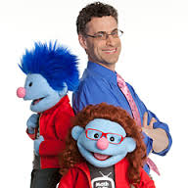
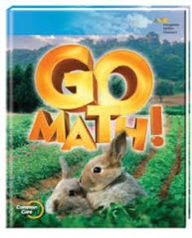
Go Math is a common-core based curriculum that covers standards for counting, measurement and data, geometry, place value, and beginning algebra.
Student Resources to view:
Student Workbook
Other Resources:
Math on the Spot

Slide 4
Our science curriculum is called Project Lead The Way
Kindergarten kits include:
Structure & Function
Pushes & Pulls
Human Body
Animals & Algorithms

Slide 5
Social Studies is taught through Studies Weekly. This program corresponds with the NC Essential Standards for Social Studies. Some themes we are covering include:
Friendship
Community
Community Helpers
Wants and Needs
Then and Now
Holidays Around the World

Slide 6
Centers
Centers are designed for independent student practice of the skills taught throughout the week. This provides the necessary time for small group teaching. There are different focuses for this small group time based on student needs. Some focuses include reading groups, individual student assessments, sight word practice, word work, etc.
Reading and math groups are small groups based on ability where we can focus on specific skills that a particular group needs.

Slide 7
What is it? Standards-based grading is a method for teachers to measure how students are doing in meeting the learning goals for their grade as determined by their state’s standards. Learning goals, sometimes called standards, are the academic skills your child should know or be able to do for his grade level by the end of the school year.
To find out more, please follow the link: http://www.schoolfamily.com/school-family-articles/article/10881-standards-based-grading-what-parents-need-to-know

Slide 8
Subject Matter Areas
3- Proficient
2- Approaching proficiency
1- Non-proficient
Characteristics of a Successful Learner
3-Meets expectations
2- Inconsistently meets expectations
1- Does not meet expectations

Slide 9
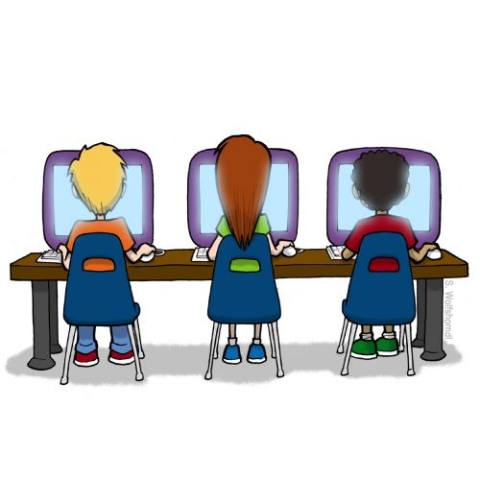
Ms. Bryant
Mrs. Ailerson
Ms. Parra
Mr. Carpenter
Mrs. Hunsaker, Mrs. Livshin, Mrs. Kidder
Mrs.Brown

