Slide 1
Welcome Kindergarteners!
Please help your child find the correct box for supplies
Fill out the transportation sheet
Then help your child find his or her cubby and seat
Please help stack up all of their folders and binders and place in the cubby. ☺

Slide 2
You will also receive all of this information in a handout in your child’s green folder and the power point has already been up loaded to my website for you to reference

Slide 3
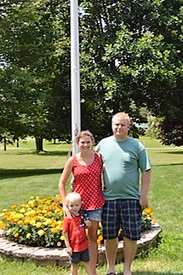
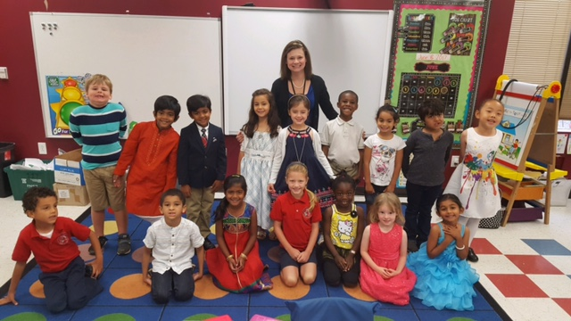
All About Mrs. McCarl
My name is Ashley McCarl and I am your Kindergarten Teacher! ☺ This is my second year here at TMSA and I am really happy to be back this year!
I live in Durham with my husband and three year old son TJ.

Slide 4
All About Mrs. Livshin
Mrs. Livshin is our fabulous Teacher’s Assistant and we are so lucky to have her. This will be her third year here at TMSA. She is so very helpful and will be with us all day long! She will also be attending lunch with your child and is a HUGE carpool help. If you have any questions for her, please email her at jlivshin@tmsacademy.org.

Slide 5
Transportation
Before you leave this morning, it is IMPERITIVE that both your child and I know how he or she is getting home. Once your transportation schedule is set, please be sure that you notify Mrs. Wood in the front office and myself of any changes.
Carpool- Please be sure that you are in the correct line and that you are patient and paying attention. It will be a LONG process the first few weeks.
Bus- If you need more information on the bus, please see Mrs. Wood
YMCA- We will help students go to the cafeteria for the YMCA at approximately 3:17
Afterschool clubs- We will help your child find their clubs for the first few weeks of school until there are comfortable going themselves.

Slide 6
Kindergarten Expectations
Behavior
Standards Based Grading
Listen when your teacher is talking.
Follow directions quickly
Raise your hand to talk
Respect yourself, other, and school
Be safe, be honest
In Kindergarten we grade on a Standards Based Grading scale. It is as follows:
3 -Meeting Grade Level Expectations
2- Inconsistently Meets Grade Level Expectations
1- Rarely Meets Grade Level Expectations

Slide 7
Homework
Homework starts in Kindergarten. We use homework to help connect families to school as well as establish good afterschool habits to prepare them for upper grades.
Homework goes home on Monday and is due the following Monday.
Please keep in mind that homework is a completion grade. It’s not there to stress you or your child out. If you aren’t sure of something, please just skip it.
Please be sure to read EVERY night and practice a sight word or two. ☺

Slide 8
Folders This year in kindergarten we will be using folders as a means of communication. Yellow- This is your Friday folder full of completed work from the week please empty this folder out and return on Mondays. Green- This is your homework and communication folder. Please check this folder and return daily. Red- This is the catch up folder and will be sent home in the event that your child did not complete their classwork or was absent from school. Blue- This folder contains class books for reading groups. This may be sent home for reading practice as needed.

Slide 9
Communication
Communication is HUGE in Kindergarten. I will do my VERY best to keep you informed in as many ways as possible.
Every week (typically on Fridays) I send home a Weekly Newsletter with the following weeks activities.
Please feel free to email me anytime. I will do my best to get back to you as quickly as possible. amccarl@tmsacademy.org
Also, I will be updating my website weekly with our class newsletter as well as adding in photos and other information as it comes up. I also have several online resources listed here and will be getting out some information and access to fun educational websites ASAP.
Mrs.McCarlKindergarten.weebly.com
I will also be trying out the communication app Remind, this will allow “texting style” communication between you and me.
I will send this information out to you ASAP so that you have access to the website and my email.

Slide 10
Lunch and Snacks
Students will be eating lunch in the cafeteria at 10:45. Please keep in mind that their lunch is only 25 minutes long.
You can send in your child’s lunch or order from the caterer. If you are ordering from the caterer, you may want to send in a little email or sticky note the first couple of times so that there isn’t any confusion.
Please be sure to send plenty of food for lunch as well as an afternoon snack. Your child will be hungry in the afternoon.
If anyone would like to send in extra snacks or back up lunch options for the class, I will keep them for days when someone needs a snack or lunch. ☺ Please be sure that it is non perishable.

Slide 11
Important Information
Bring a complete change of clothes (accidents happen!!)
We celebrate birthdays in the afternoons, before dismissal if you would like to bring in a birthday treat please let me know and be mindful of allergies.
Please be sure to label everything!!! Imagine a Lost and Found with 200 blue fleece jackets! YIKES!
Attendance- Please arrive before 8:00 so that our day can get started on time. If your child will not be at school, please be sure to email sbell@tmsacademy.org as well as myself so that we can properly mark their attendance.

Slide 12
Please say goodbye and head to the auditorium for orientation.
Thank you so much for coming! I really look forward to getting to know you and your families have a wonderful day and if you have further questions, please be sure to check the website or email me. I’m happy to help!

